Slide 1

ESOF 422: Advanced Software Engineering: Cyber Practices
Network Forensics, Course Conclusion
Reese Pearsall
Spring 2025

Slide 2

Announcements
HW6 is fully done. No part 3 (sorry).
Friday will be an optional workday for HW6 (no new materials)
Final Exam: Wednesday May 7th 2:00 PM – 3:50 PM
Fill out the course evaluation

Slide 3
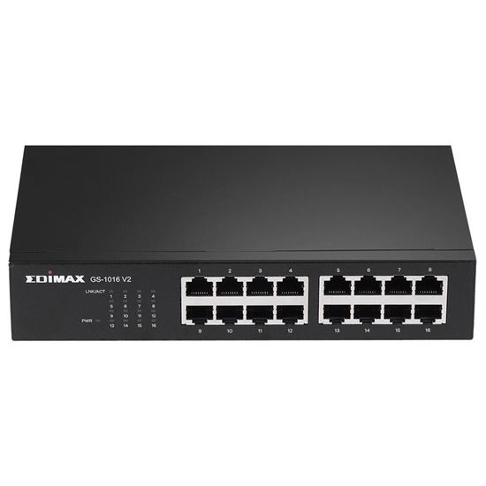

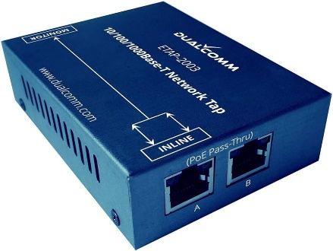
Network Forensics
Network Forensics- digital evidence is coming from traffic of a computer network
Able to see data leaving and coming to machine
May be helpful for timelining
You will usually be working with PCAP files

Slide 4
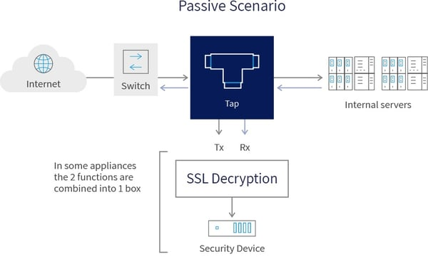
Challenges with Network Forensics
Capturing network traffic for analysis is becoming less and less feasible due to data transmission and storage limitations
Takes a long time to sift through thousands of packets
100 MBPS x 7 days per week = 7.56 TB
10 GBPS x 7 days per week = 756 TB
Think about keeping track of this for all machines at your organization…
May have to decrypt in-line/MITM traffic
Difficult to capture in a cloud network

Slide 5

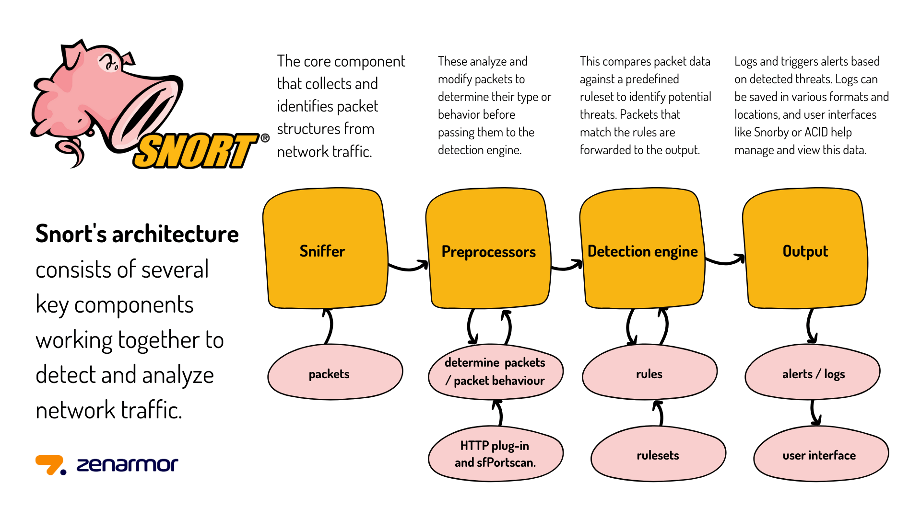
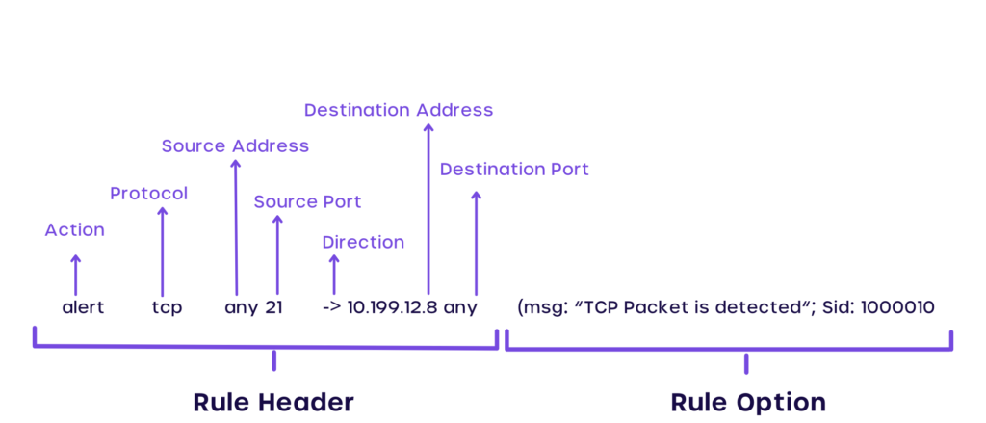
SNORT
A set of rules to detect suspicious/malicious traffic
If we satisfy a rule, an alert can be generated or that packet can be logged
Alerts for malicious IP addresses, typical malware behavior, log unusual ports
This rule would generate an alert for web traffic that is not using the secure version of HTTP
alert tcp any any → any 80 (msg:”Sus web traffic”; flags: S; sid: 100;)

Slide 6
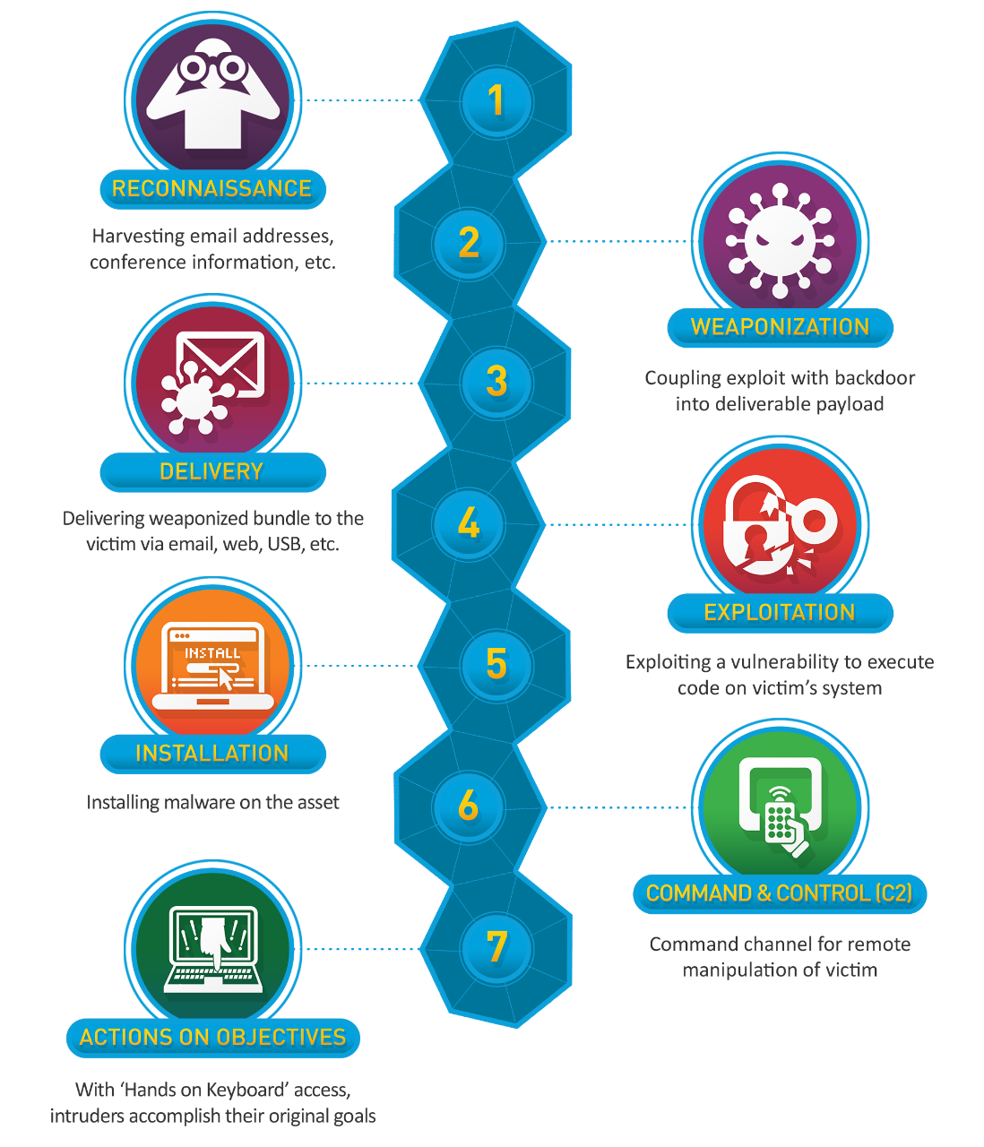
The Cyber Kill Chain describes the typical steps a malicious actor carries out to conduct a cyber attack
In network forensic investigations, we can see evidence of these steps occurring!

Slide 7
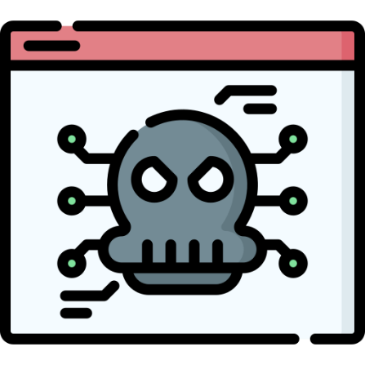

Common Malware Behavior (Network Traffic)
Downloading malware/malware dropper through HTTP
Communicate with a C2 server
- Cobalt Strike
- Metasploit
- Covenant
Unusual Outbound Traffic
Malware Beaconing
Suspicious DNS Queries to attacker domains
Spike in connections to other devices (lateral movement)
Failed login attempts/authentication

Slide 8
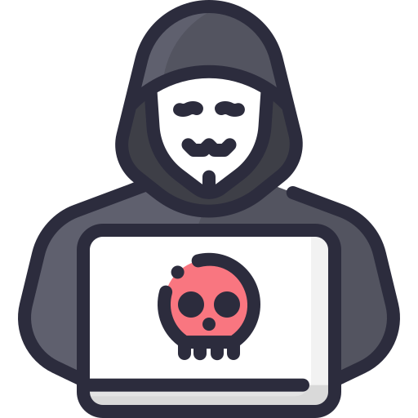

Cobalt Strike C2 Server Threat Hunting
Use of default SSL certificates
Increased usage of port 443, 80, 8443 with foreign IP address
Check default responses for HTTP 404 and DNS Queries

Slide 9
Malware File Types to Check for
.exe files - Windows executable files
.dll files - Dynamic Linked Libraries
.msi files – Windows installers
.bat files – Windows command line script
.vbs scripts – Visual Basic Scripts
.js scripts – Javascript file
.docx files – Microsoft Word Document (can contain macros)
.xlsx files – Microsoft Excel Spreadsheet (can contain macros)
.zip files – Compressed Archive Files (may have scripts when unzipped)
.pdf files – Can contain suspicious links, or a PDF reader vulnerability

Slide 10
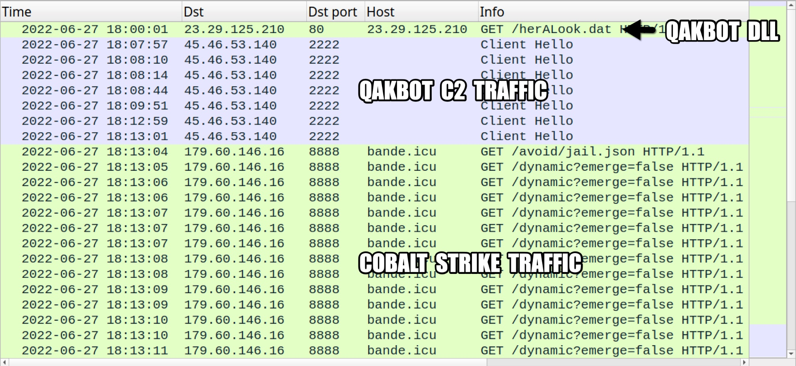
Wireshark
We can use Wireshark to identify specific malicious packets, and find the exact moment where the infection started
C2 server information, Victim information, other relevant evidence

Slide 11
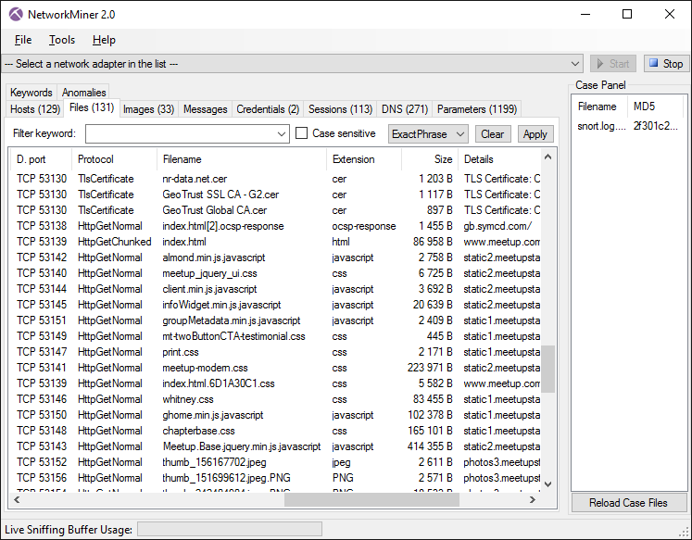

NetworkMiner
NetworkMiner is a automated flow analysis tool that will identify all hosts, downloaded files, emails, logins from a pcap file and attempt to reassemble them for analysis
Very powerful tool that can provide many helpful insights during an investigation
NetworkMiner should always be run in a sandbox environment (VM) that is disconnected from the network

Slide 12
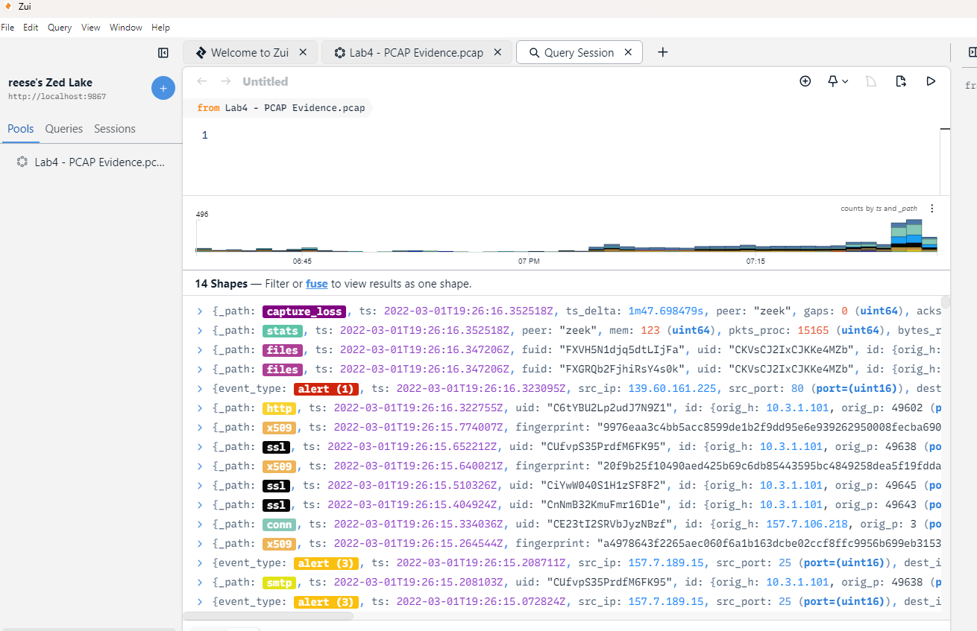
Zui
Zui (formerly known as brim) is a automated flow analysis tool that will identify any suspicious packets, emails, certificates, files from a pcap file and create a timeline
Won’t assemble the files, so it will be safer to use
Can help identify potential IOCs

Slide 13
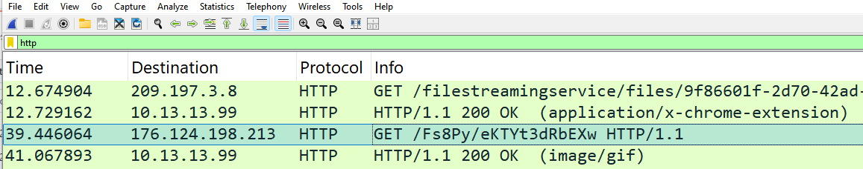
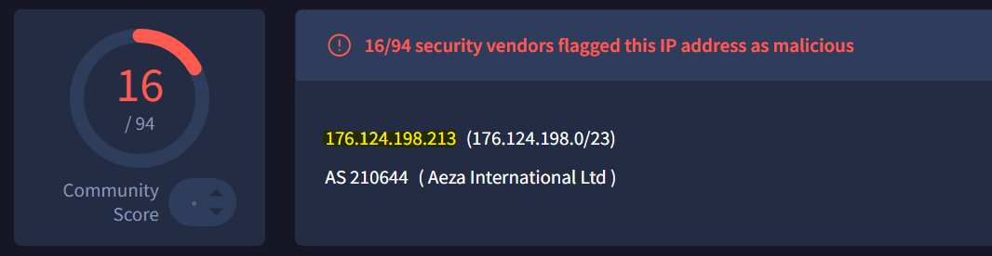
First, let’s try to find the piece of malware that was installed
This HTTP Get request seems suspicious
Strange URL in the header
VirusTotal confirms that this IP address is malicious

Slide 14
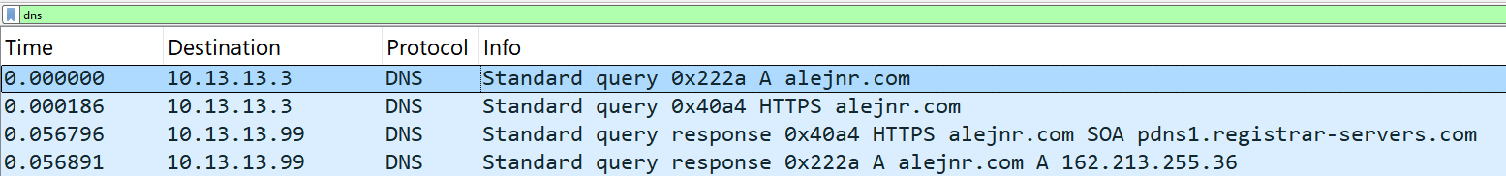
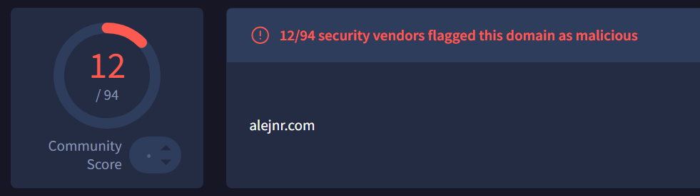
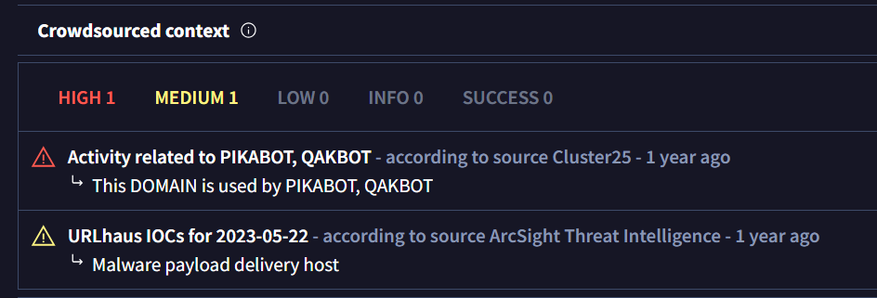
Investigating DNS
Many of the DNS requests were made to “normal” website. However, this domain seemed a bit strange and this request was made shortly before the malicious HTTP request
This domain had been flagged as malicious in the past
VirusTotal also provides context as to why it was flagged as malicious

Slide 15
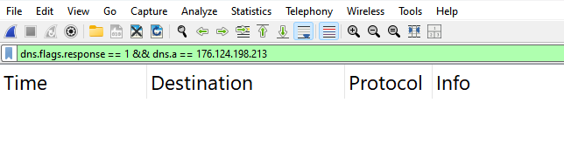
Where did this IP address come from?
This malicious IP did not come from a DNS response.
This could be an indicator that another piece of malware contacted that IP addressed and issued the HTTP request (malware dropper)
Many of the DNS requests were made to “normal” website. However, this domain seemed a bit strange and this request was made shortly before the malicious HTTP request

Slide 16
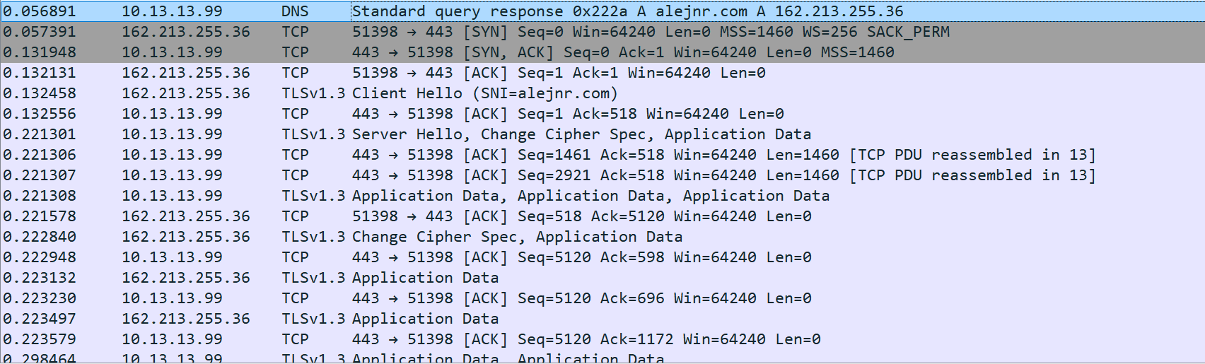
Immediately after we resolve the host name of alejnr.com, we start a TCP/TLS connection with that

Slide 17

Theory:
We reached out to this malicious domain alejnr.com and downloaded a malicious file which issued this HTTP request
We stop talking to that malicious domain, and then shortly after the malicious HTTP GET request is done

Slide 18
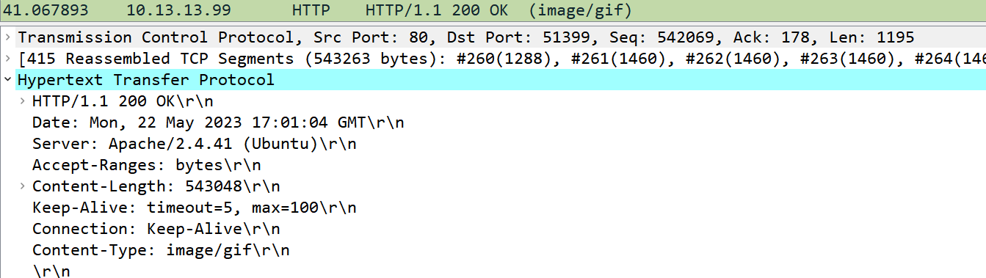
What is in this malicious HTTP request?
Request
Response
Wireshark thinks this file is GIF
Wireshark notices that there is something weird going on…

Slide 19
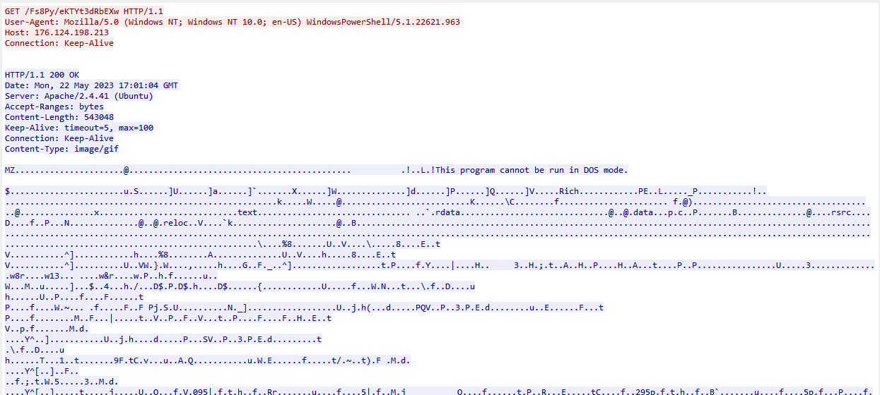
What is in this malicious HTTP request?
Right click → Follow TCP Stream
This is the “raw” contents of the GIF file
There is something very wrong here…

Slide 20

What is in this malicious HTTP request?
Right click → Follow TCP Stream
“This program cannot be run in DOS mode” is a very special string that appears in almost every Windows executable (.exe) or DLL file
It doesn’t make sense that this is part of a GIF file

Slide 21
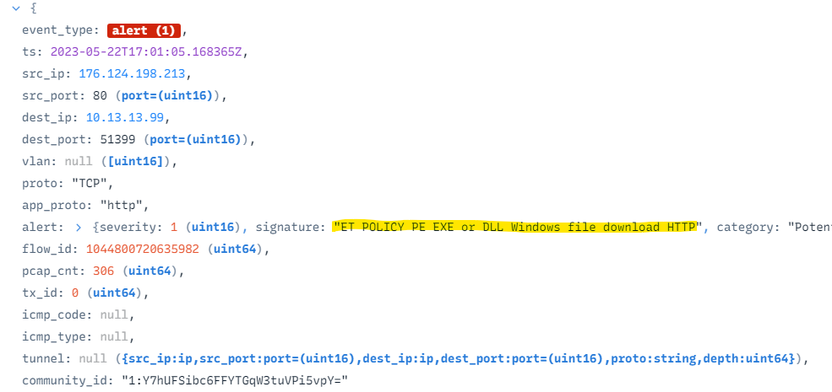
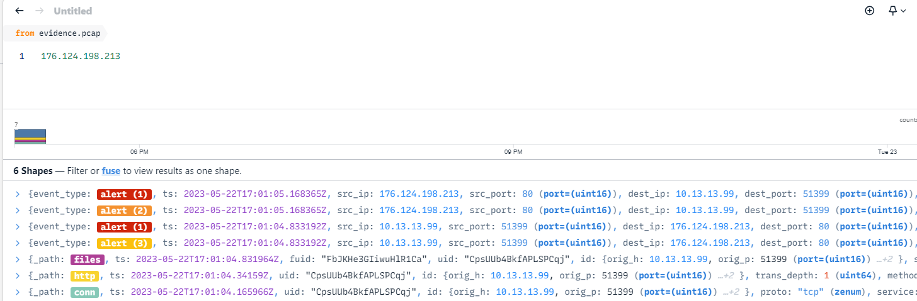

What is this malicious DLL file?
ZUI actually determined something malicious was possibly going on from our PCAP file
We can plug our malicious IP from the GET request into ZUI
We can expand the “files” info to see information about this file that was downloaded

Slide 22
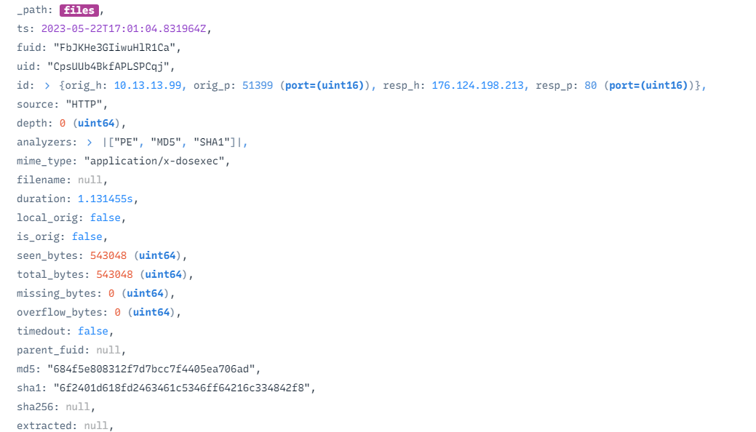
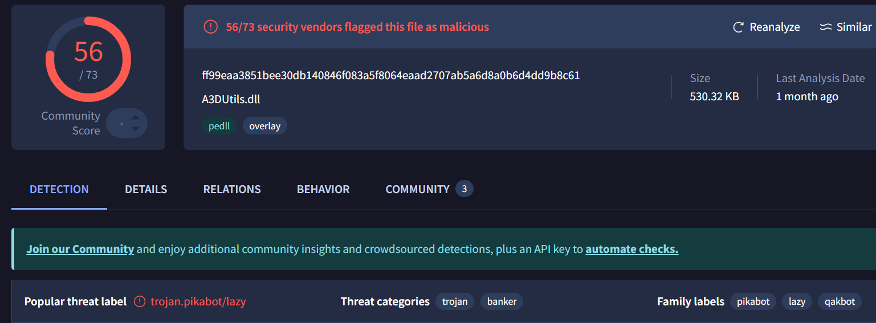



What is this malicious DLL file?
By plugging it into VirusTotal, we can see that this DLL file-pretending-to-be-a-gif is a known malicious file!
ZUI will compute the file hash for us !
The name of this malware is “PIKABOT”
VT seemed to redirect to the SHA256 hash value

Slide 23


What is this malicious DLL file?
This domain had been flagged as malicious in the past
VirusTotal also provides context as to why it was flagged as malicious
We saw “PIKABOT” earlier when we were investigating alejnr.com
The name of this malware is “PIKABOT”
VT seemed to redirect to the SHA256 hash value

Slide 24
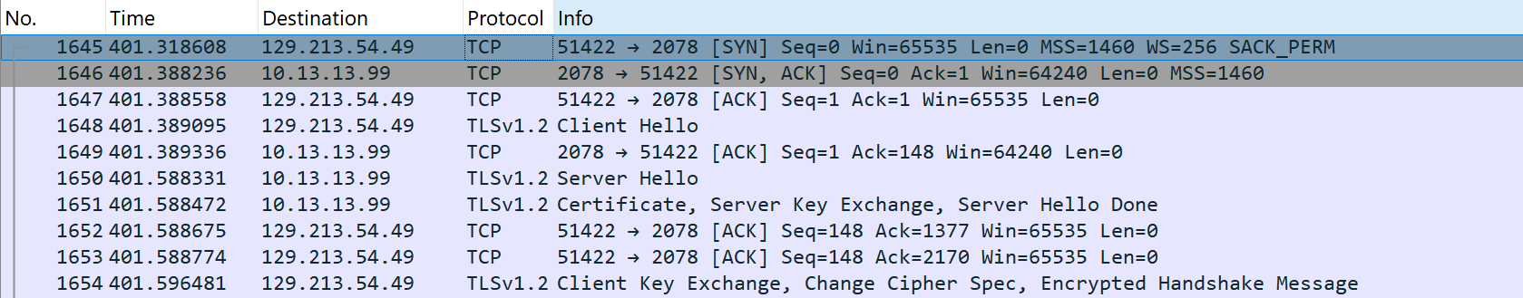
What happens after the malware was downloaded?
Let’s see if we can find evidence of command and control from this cyber attack
We can start plugging in IP addresses into VirusTotal to see if we get a hit

Slide 25
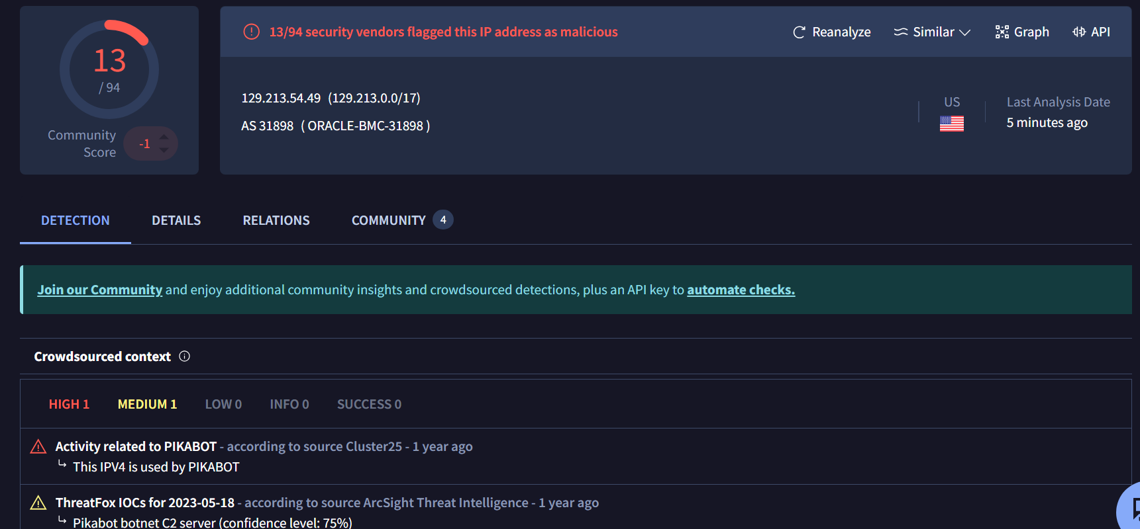

What happens after the malware was downloaded?
Let’s see if we can find evidence of command and control from this cyber attack
We discover that 129.213.54.49 is the IP address for the PIKABOT C2 server

Slide 26
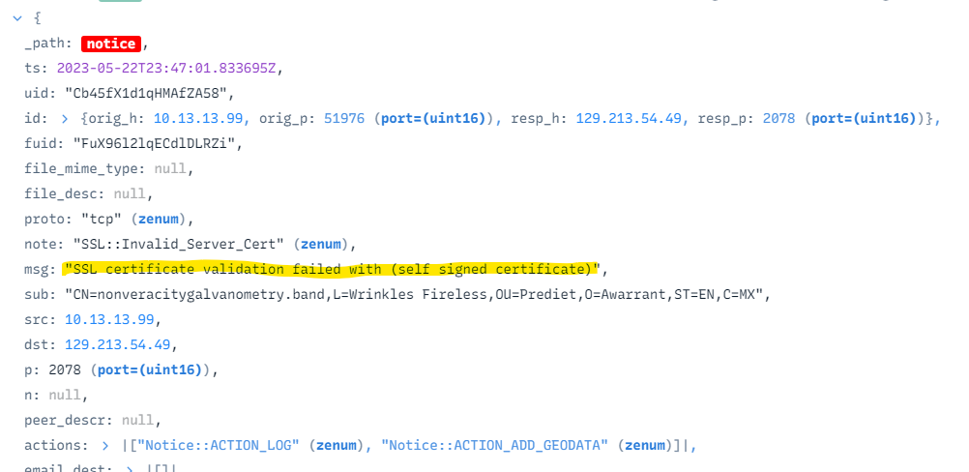

What happens after the malware was downloaded?
Let’s see if we can find evidence of command and control from this cyber attack
ZUI also generated a notice that this could possibly be a C2 server

Slide 27
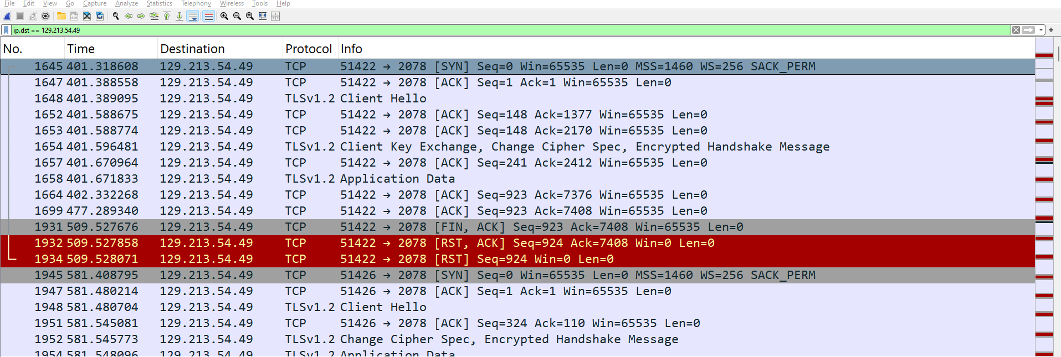
What damage was done?
A good amount of Data was exchanged with the C2 server
Since this all HTTPS encrypted traffic, we cannot see the content of these messages
However, this is evidence that it is possible that data may have been exfiltrated

Slide 28







Timeline
162.213.255.36
alejnr.com was contacted
Connection with alejnr.com was made and malware dropper was installed
2023-05-22T17:00:24
176.124.198.213
How did this attack begin?
PikaBot DLL downloaded
2023-05-22T17:01:04
129.213.54.49
Possible Data Exfiltration ?
PikaBot C2 server contacted

Slide 29
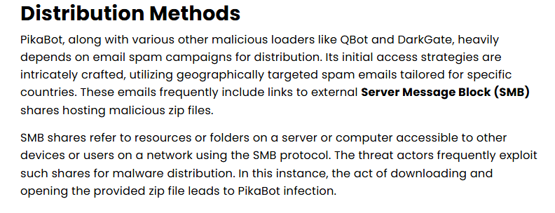
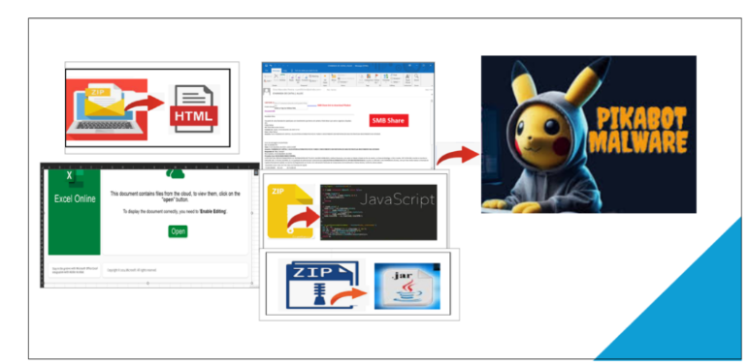
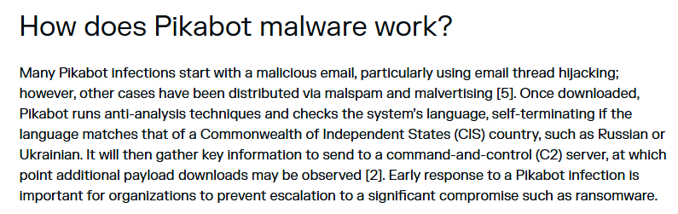

Finding Root cause
PIKABOT is a well-documented malware. We can do a little bit of investigation ourselves to figure out what happened
Full IOC: https://github.com/pan-unit42/tweets/blob/master/2023-05-22-IOCs-for-Pikabot-infection-with-Cobalt-Strike.txt

Slide 30
Final Exam Review

Slide 31
Exam Logistics
13.33% of your final grade
Wednesday May 7th 2:00 PM – 3:50PM in this classroom
Exam Length: 110 minutes (shouldn’t take that full time)
This exam is optional
If you don’t show up, I will use the average of Exam 1 and Exam 2 for your Final Exam score
Format will be similar to your other two exams
Short answer
May give you a diagram, and ask you some questions about it
Might have you look at some code
You are allowed to use any physical notes (printouts, handwritten/typed notes)
You are not allowed to use any digital devices
Exam will mostly cover materials from the second half of the semester, but there will be a couple questions from the first half of the semester

Slide 32
Stuff from first half of semester
I’d recommend reviewing the stuff from the first couple weeks
OOP Principles and mechanisms
Design Patterns

Slide 33
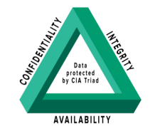
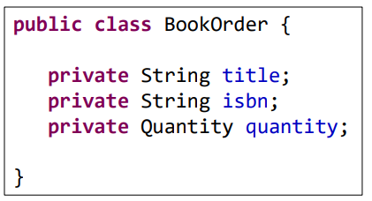
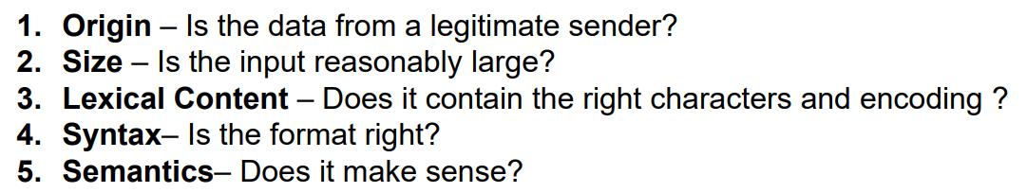
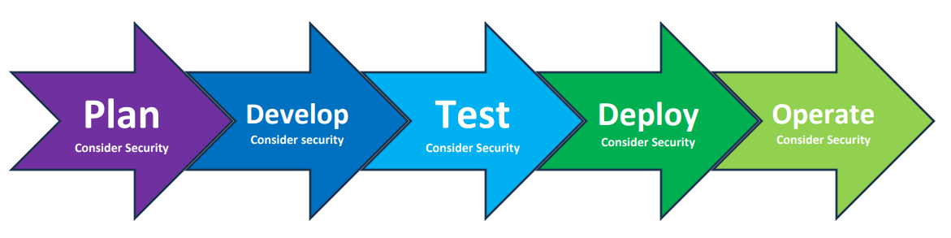

Secure by Design
CIA Triad
Domain Primitives
Principle of Fail-Fast
Domain Driven Design
Object Mutability
Input Validation Steps
Secure Development Lifecycle
Defense in Depth

Slide 34
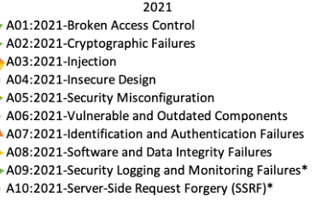
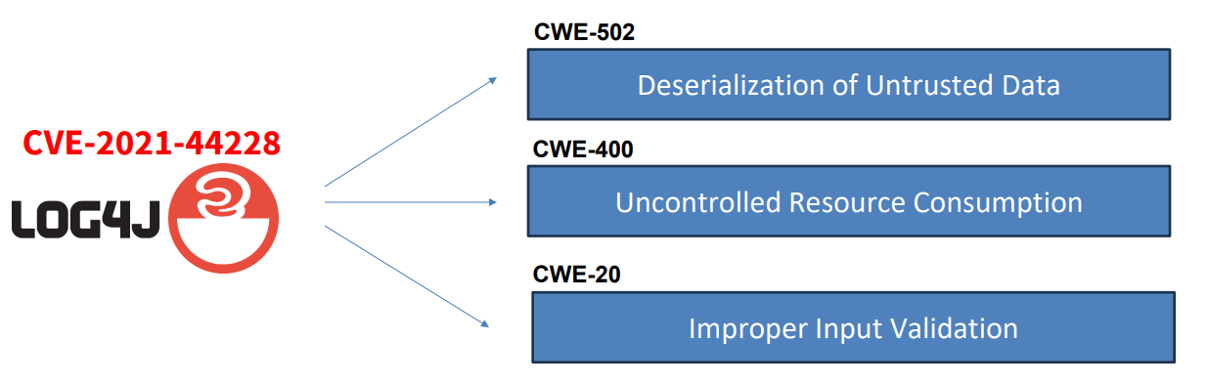
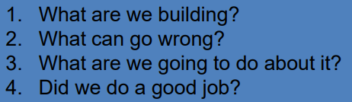
Vulnerability Analysis
Common Vulnerabilities and Exposures (CVE)
Common Weakness Enumeration (CWE)
Bug Bounties
NIST
Attack Vectors, Attack Surface
OWASP Top 10
Threat Modeling
STRIDE
Options for dealing for threat

Slide 35
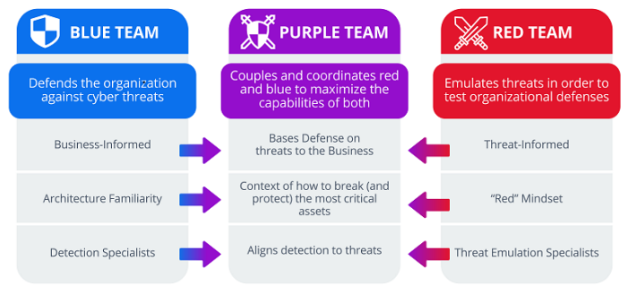

Penetration Testing
What is penetration testing
Types of penetration tests
Penetration testing phases
OSINT
Metasploit
Metasploit Terminology + Modules
nmap and ports
Post-Exploitation Tactics

Slide 36
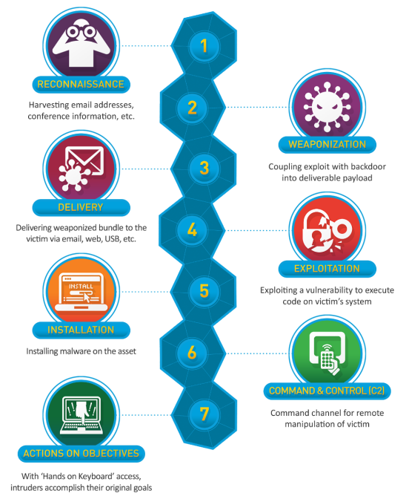
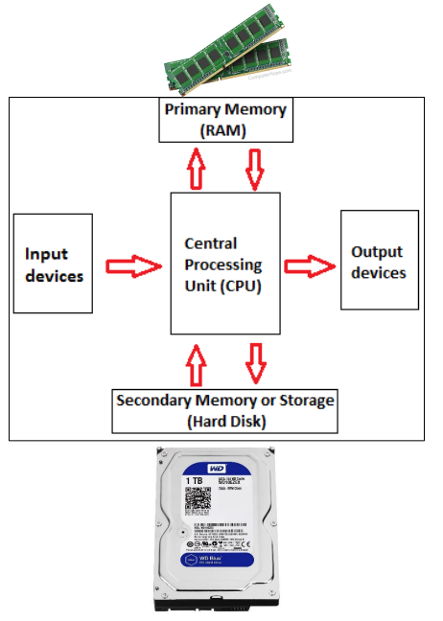
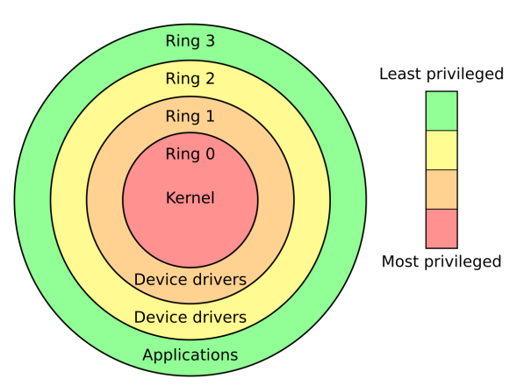

Digital Forensics
What is digital forensics
Goals of digital forensics
Types of Forensics
Digital Evidence Collection
Principles of Digital Forensics
Precursors, Indicators of Compromise
Threat Detection and Analysis (Classification Errors)
Pyramid of Pain
Cyber Kill Chain
Recovery, Containment, Eradication
CISA
OS Fundamentals
Malicious Behavior
Volatility
Helpful Volatility Plugins and DF Tools
General steps of investigation with volatility

Slide 37
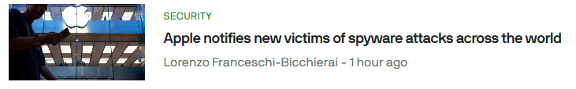
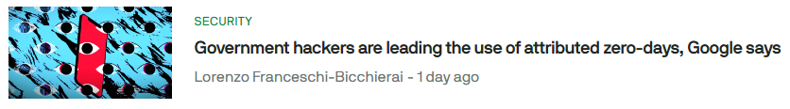
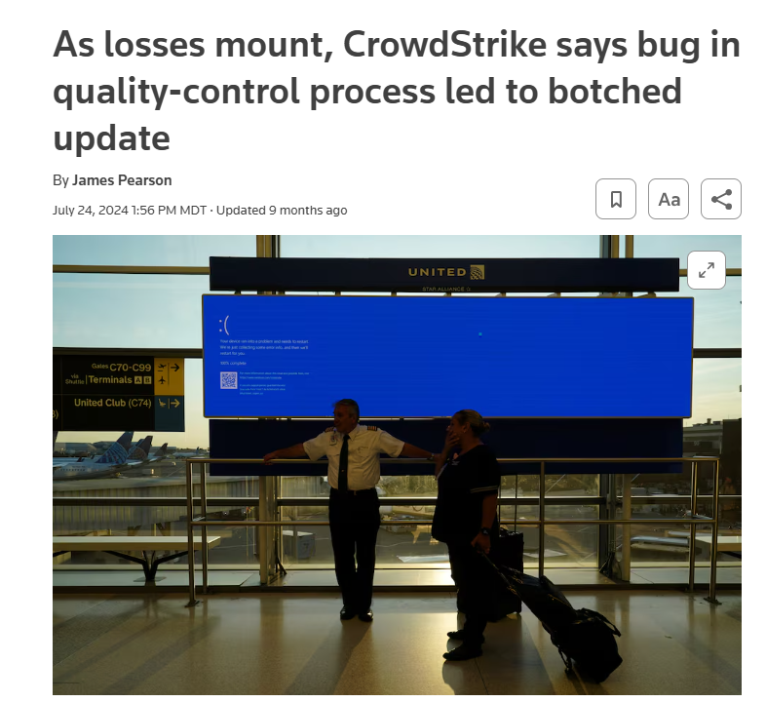
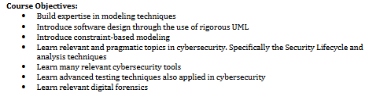
Course Outcomes, Lessons Learned
Deep modeling ensures a better design
Software testing is important
Design decisions should be made with cybersecurity in mind
It’s important to understand common vulnerabilities and weaknesses
It’s important to threat model your system
Penetration Testing is a great way to identify flaws
Digital Forensics investigations are vital for responding to an incident and dealing with a threat

Slide 38
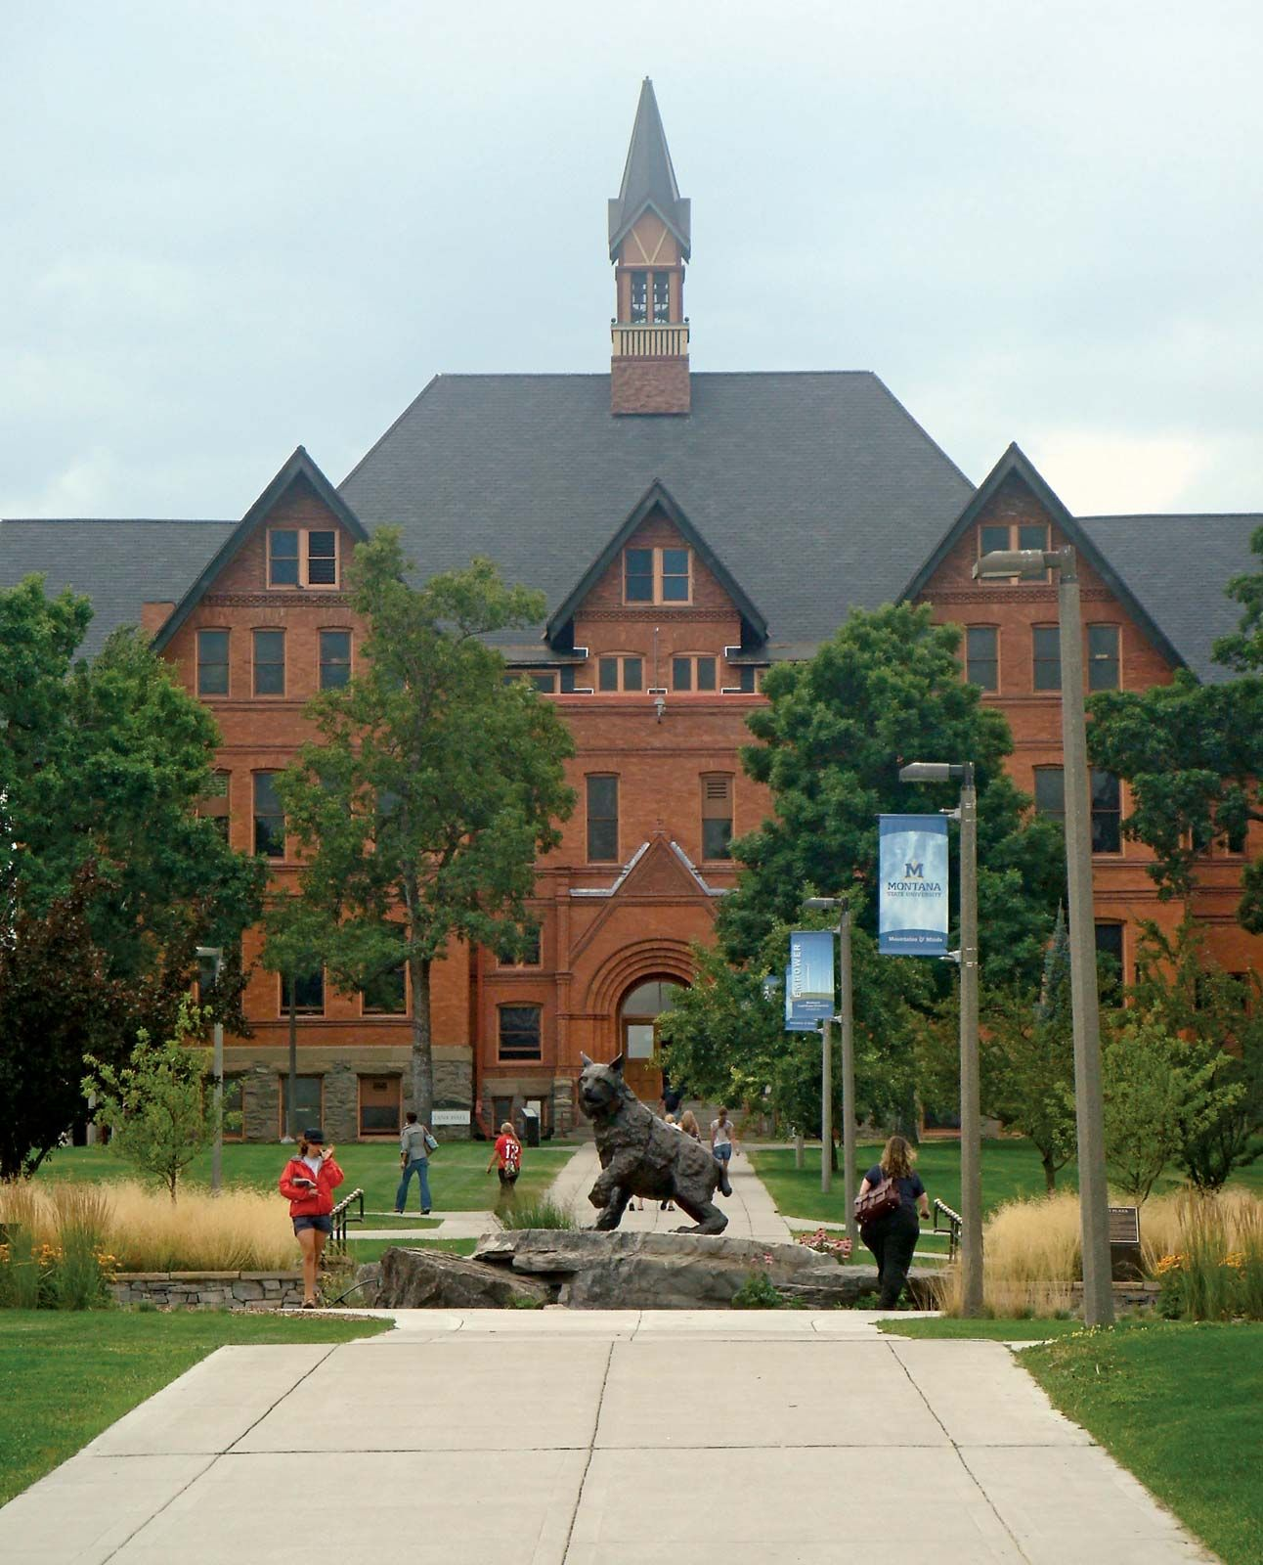
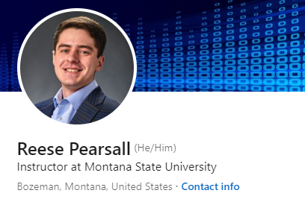

Thank You!
I hope you enjoyed this class, and I hope the stuff you learned will be helpful in your career/future classes
If I can be of assistance to you for anything in the future (reference, advising, support), please let me know!
I will be teaching CSCI 232, 466, 476 next semester
Connect with me on LinkedIn!
If you find a job in cybersecurity or cyber practices, please keep in touch!
Congrats to those that are graduating next weekend! I hope you find a job that you love!

